Slide 1

Optimal Location for Opening a Restaurant
IBM Data Science Capstone Project
Nishit Chaudhari

Slide 2
Introduction: Business Problem
Asian food is gaining popularity in England lately. In England center, Thai, Chinese and even Indian restaurants are opening everywhere, and are always full whatever is the hour. The aim of this Project is to find the best localization to open a restaurant business in capital of England and United Kingdom, London City.
Prior launching any restaurant, it’s important to know if the business as a good opportunity. In order to do so, this report will try to gather data about other restaurant localization, competitors and best localization.
We will use our data science powers to generate a few most promising neighborhoods based on these criteria. Advantages of each area will then be clearly expressed so that best possible final location can be chosen by stakeholders.

Slide 3


Data
Following data sources will be needed to extract/generate the required information:
centers of candidate areas will be generated algorithmically and approximate addresses of centers of those areas will be obtained using Geocoder reverse geocoding Python package as recently Google started charging for their API.
Number of restaurants and their type and location in every neighborhood will be obtained using Foursquare API coordinate of London center will be obtained using Geocoder geocoding Python package of well-known London location (Trafalgar Square)
Following is some change in data:
Country/City: London, England.
Goal: Open a restaurant/little shop.

Slide 4
Methodology
1. Neighborhood Candidates
First step is to create latitude & longitude coordinates for centroids of our candidate neighborhoods. We will create a grid of cells covering our area of interest which is approx. 1.5km kilometers centered around London city center.
2. City partitioning
Now let's create a grid of area candidates, equally spaced, centered around city center and within ~1.5km from Trafalgar Square. Our neighborhoods will be defined as circular areas with a radius of 100 meters, so our neighborhood centers will be 200 meters apart.

Slide 5
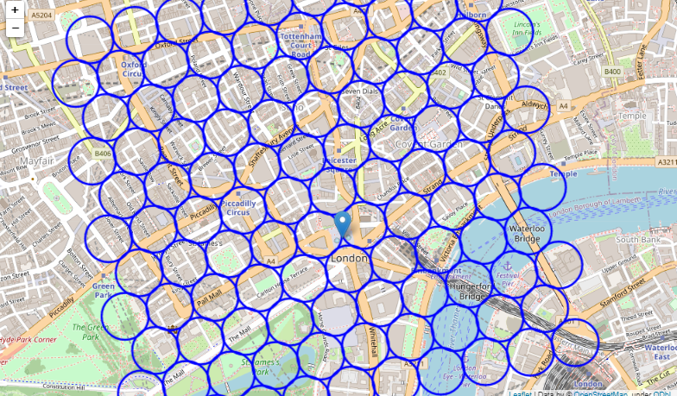
Let's visualize the data we have so far: city center location and candidate neighborhood centers:

Slide 6
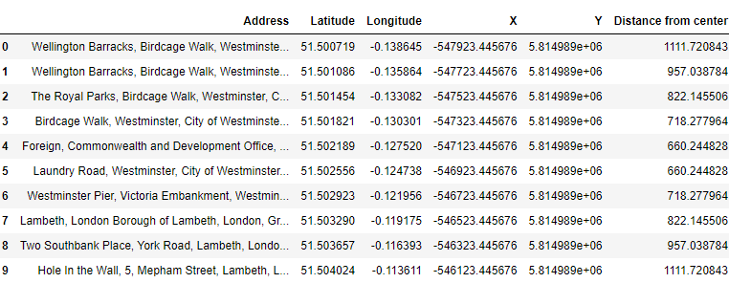
3. Address Locations
Now use Geocoder Python package to get approximate addresses of those locations and place all this into a Pandas data frame.

Slide 7
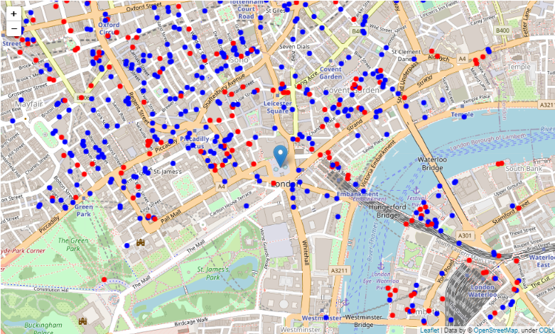
4. Foursquare
We're interested in venues in 'food' category, but only the ones who can be competitors, this mean food truck, quick food, take away, healthy, not restaurant taking too long.
We will also list all companies and university to evaluate the customer pool. Now see all the collected restaurants in our area of interest on map, and let's also show Asian restaurants in different color

Slide 8
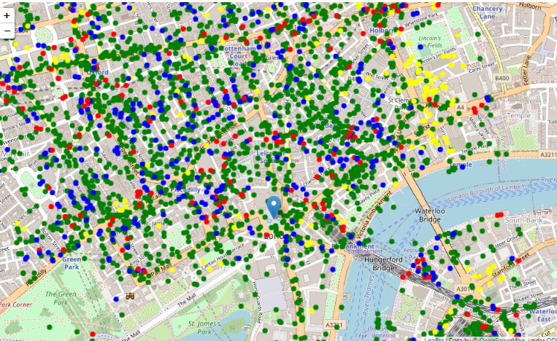
Global map of worker/students versus Restaurants (Asian restaurants = red, Universities = yellow, companies = green, other restaurants = blue)
we have a map with the big companies and universities, we can then already see main areas with potential customers.
After visualization of data, we can conclude:
Competitors are scattered around the city.
Trafalgar Square is crowded with companies everywhere within the 1.5km region
Universities are mostly crowded to the east and north-east regions.

Slide 9
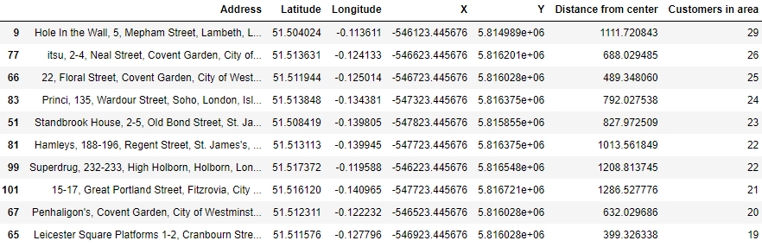
Analysis
1. Average number of customers
Perform some basic explanatory data analysis and derive some additional info from our raw data. First count the number of businesses in every area candidate and then find average number of customers in every area with certain radius. Putting it all in pandas' data frame for better visualization:

Slide 10
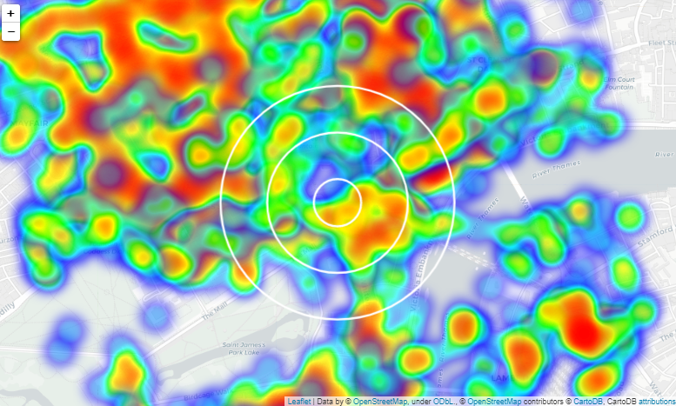
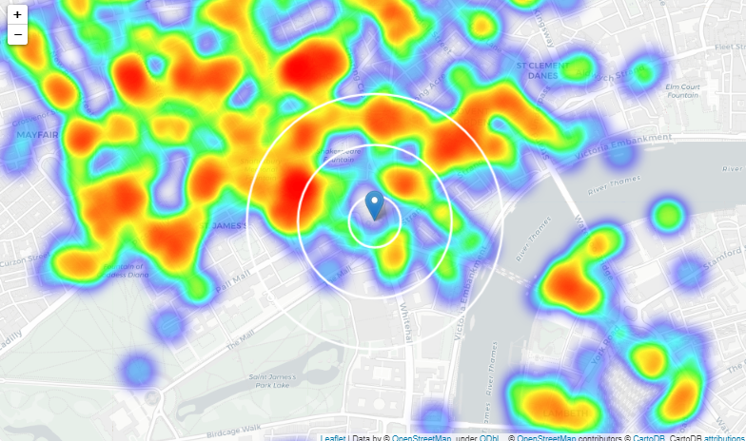
Analysis
2. Heatmap/density of customers.
3. Heatmap/density of restaurants.

Slide 11
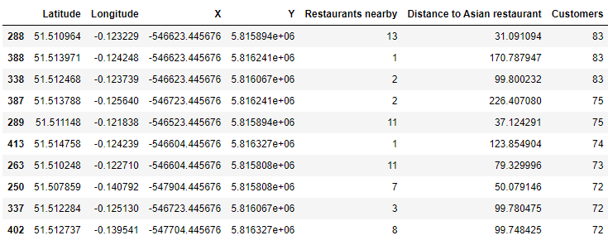
4. K mean clustering
Calculate two most important things for each location candidate: number of restaurants in vicinity (we'll use radius of 150 meters) and number of customers.

Slide 12

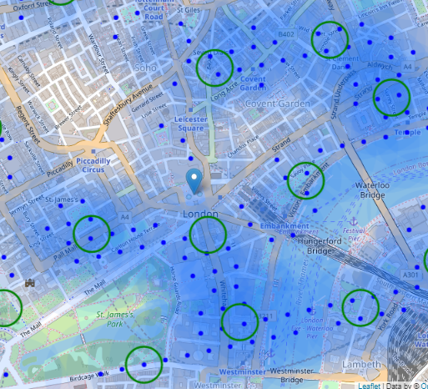


Now filter those locations: we're interested only in locations with no more than two restaurants in radius of 250 meters, and no Asian restaurants in radius of 100 meters, and more than 10 customers.
Now cluster those locations to create centers of zones containing good locations. Those zones, their centers and addresses will be the final result of our analysis.
Finally, let's reverse geocode those candidate area centers to get the addresses which can be presented to stakeholders.

Slide 13
Results and Discussion
London is a very big city, the concentration of restaurant at the center is quite high due to the various famous landmarks situated there, in this analysis the idea was to correlate the number of restaurant and quantity of potential customer based on the factors of number of companies and universities nearby.
We first created a dense grid of location candidates (spaced 100m apart); those locations were then filtered so that those with more than two restaurants in radius of 250m and those with an Asian restaurant closer than 100m were removed
Those location candidates were then clustered to create zones of interest which contain greatest number of location candidates.
Result of all this is 15 zones containing largest number of potential new restaurant locations based on number of and distance to existing venues .
This, of course, does not imply that those zones are actually optimal locations for a new restaurant! Purpose of this analysis was to only provide info on areas close to London center but not crowded with existing restaurants (particularly Asian)

Slide 14
Conclusion
Purpose of this project was to identify London areas close to center with potential customer count in order to aid stakeholders in narrowing down the search for optimal location for a new Asian restaurant.
By calculating restaurant density distribution from Foursquare data, we have first identified general locations that justify further analysis
Clustering of those locations was then performed in order to create major zones of interest and addresses of those zone centers were created to be used as starting points for final exploration by stakeholders.
Final decision on optimal restaurant location will be made by stakeholders based on specific characteristics of neighborhoods and locations in every recommended zone, taking into consideration additional factors like attractiveness of each location (proximity to park or water), levels of noise / proximity to major roads, real estate availability, prices, social and economic dynamics of every neighborhood etc.

